Slide 1
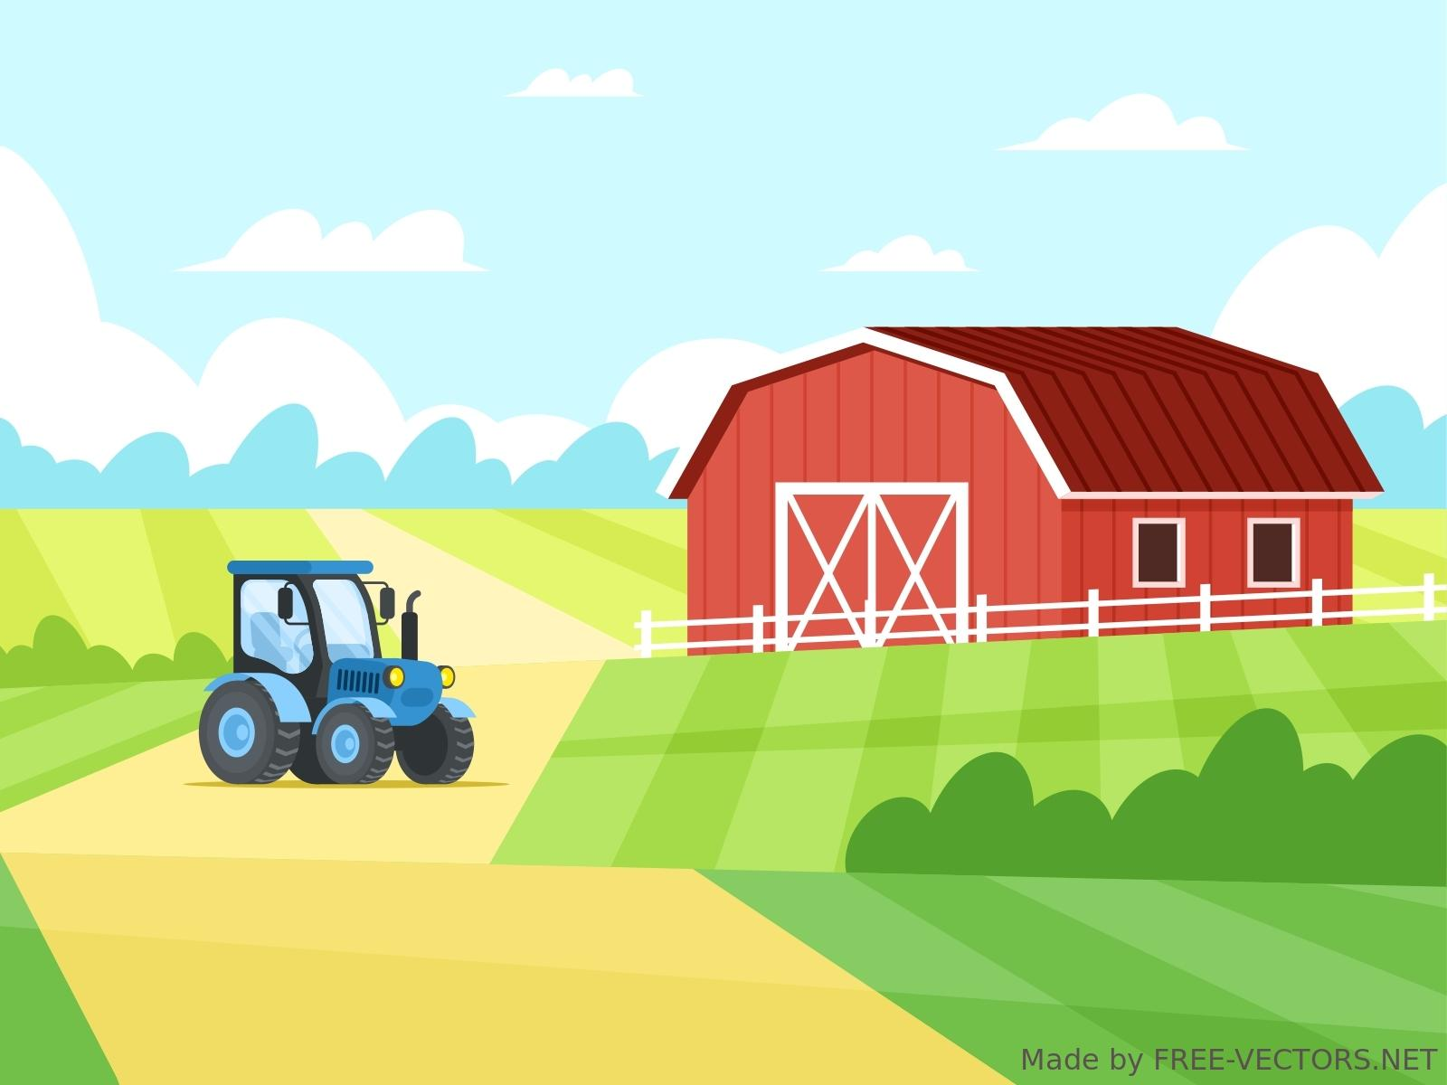
Escape room
Slovenia

Slide 2
Press any key

Slide 3
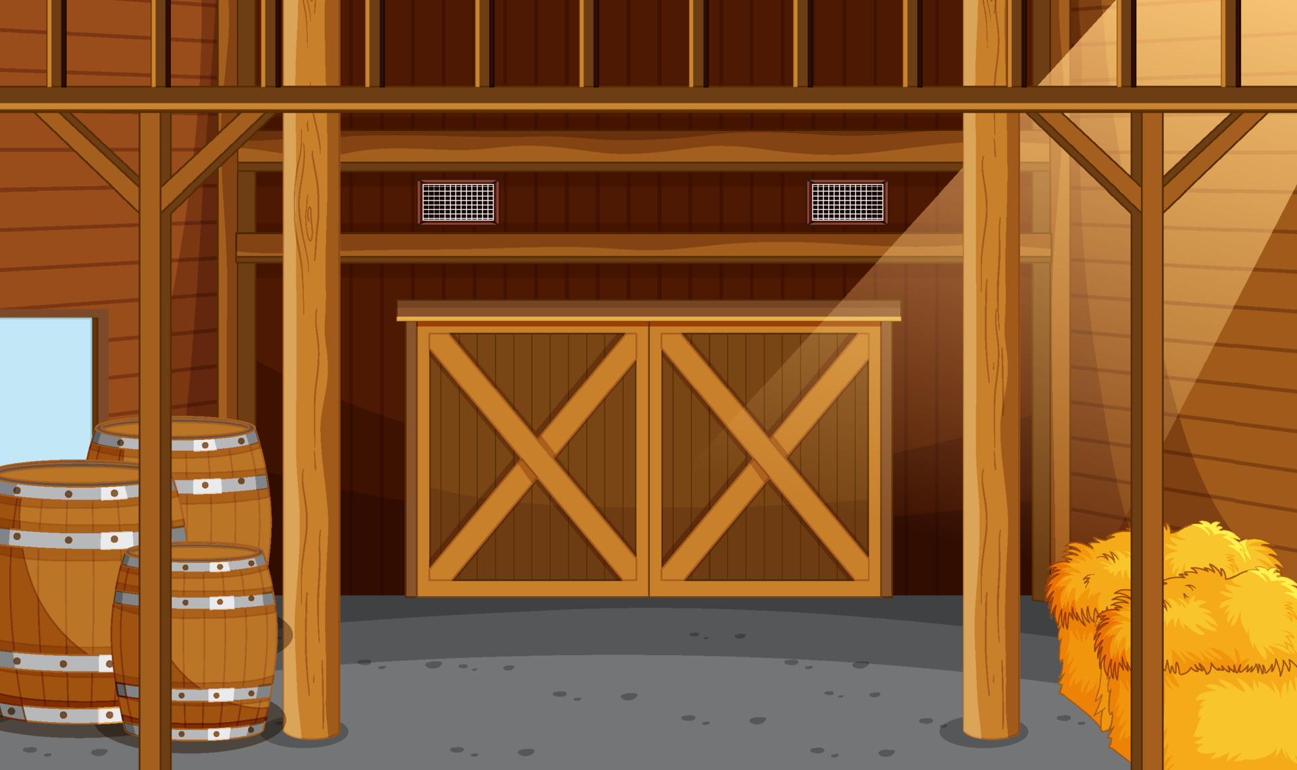
HA-HA! I’ve caught you now!!!
You’ve been trapped in an old castle forever. The only way to escape is to solve all my puzzles.
Instructions:
Do not press the spacebar, arrows or keyboard at any time!

Slide 4
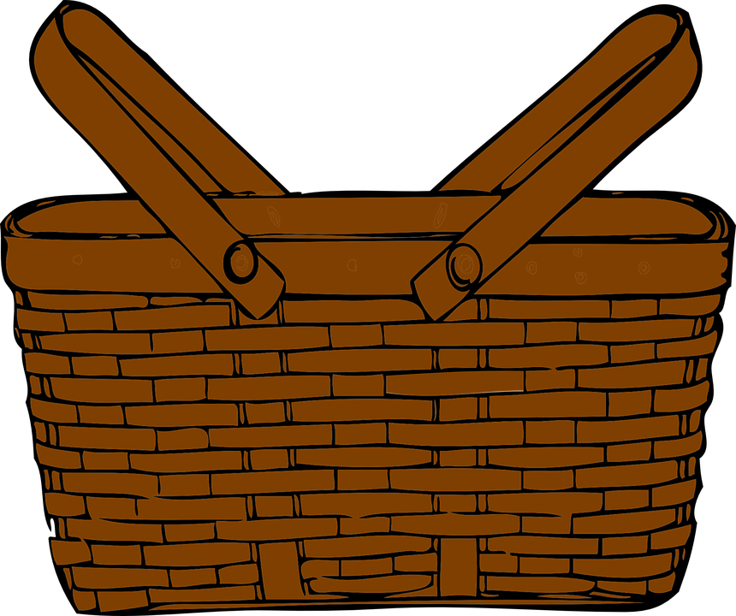
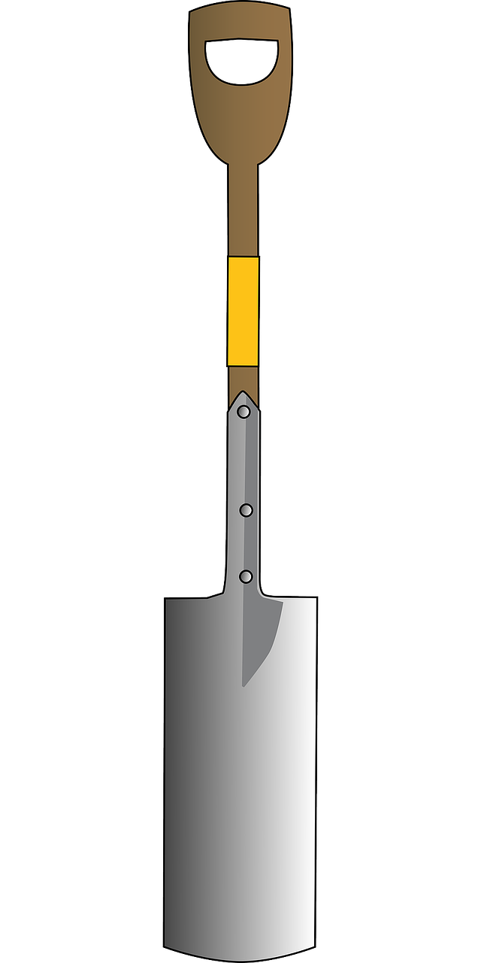
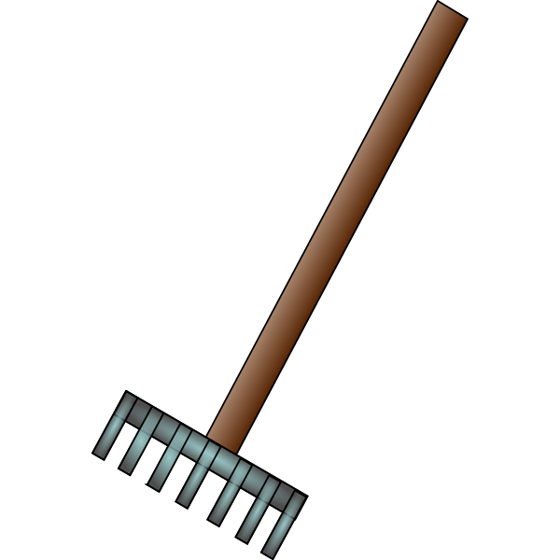

Slide 5
A goat eats 3 kg of hay, a cow eats 15 kg of hay, and a rabbit eats only 1 kg of hay. How many kg of hay does the cow eat more than a goat and a rabbit together?
19 kg
11 kg
12 kg

Slide 6
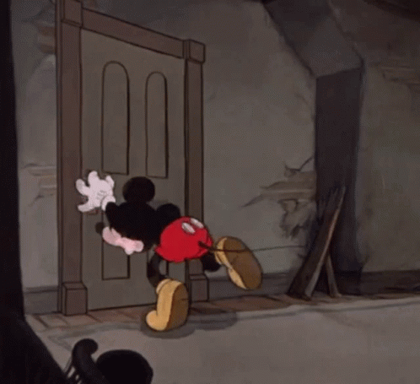
You are still trapped!
Try again

Slide 7
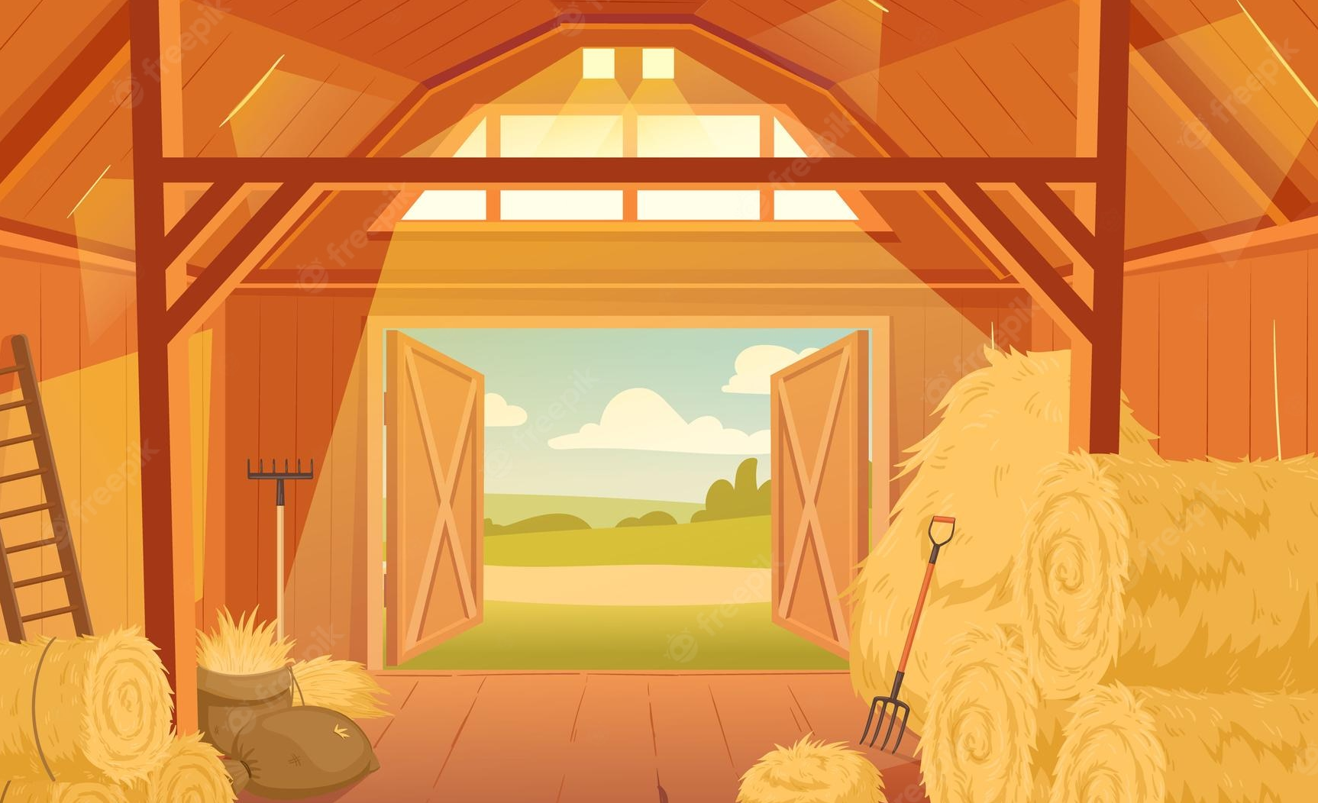
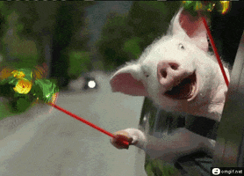
One step closer to freedom!
Correct!
Solve another puzzle

Slide 8
In the spring, several animals were born on the farm. The goat gave birth to twins, the rabbit had as many as seven and the mare gave birth to a foal. How many offspring were born?
9
8
10

Slide 9
You are still trapped!
Try again

Slide 10
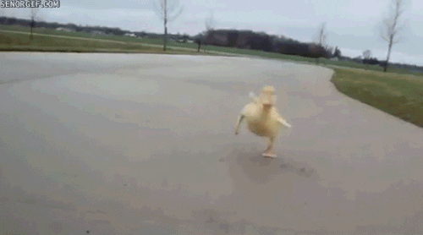
One step closer to freedom!
Correct!
Solve another puzzle

Slide 11
Farmer Simon wants to buy some animals for his farm. He saved up €100. He is going to buy a foal for €35 and a sheep for €17. How much money does he have left?
52 €
84 €
48 €

Slide 12
You are still trapped!
Try again

Slide 13
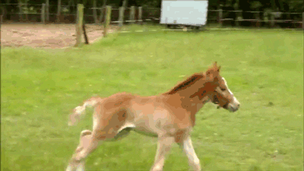
One step closer to freedom!
Correct!
Solve another puzzle

Slide 14
Have you solved all three tasks yet?
YES
NO

Slide 15
What three animals were shown in the GIFs by the correct puzzle answers?
A cow, a pig,
a duck
A horse, a pig,
a hen
A horse, a pig,
a duck
A horse, a goat, a duck

Slide 16
Correct!
Escape!

Slide 17
Project: Maths is Fine with Digital Style
Project number: 2021-1-CZ01-KA220-SCH-000027773
The European Commission's support for the production of this publication does not constitute an endorsement of the contents, which reflect the views only of the authors, and the Commission cannot be held responsible for any use which may be made of the information contained therein.

